Slide 1
HELLO EVERYONE!!!
Letting me talk about ciphers was a terrible idea

Slide 2
VIGENERE CIPHER
CSC 15 10/24/2025
NOVA & XAVIER
a.k.a. “To the shock of nobody, another rotary/substitution cipher”

Slide 3
TWO TRUTHS
AND A LIE (about today’s topic)
FACT #1
FACT #2
FACT #3
Blaise De Vigenere invented the “Vigenere Cipher”
The Vigenere Cipher was considered unbreakable for around 3 centuries
This cipher boils down to: “What if we did Caesar… twice?” (Revolutionary idea)

Slide 4
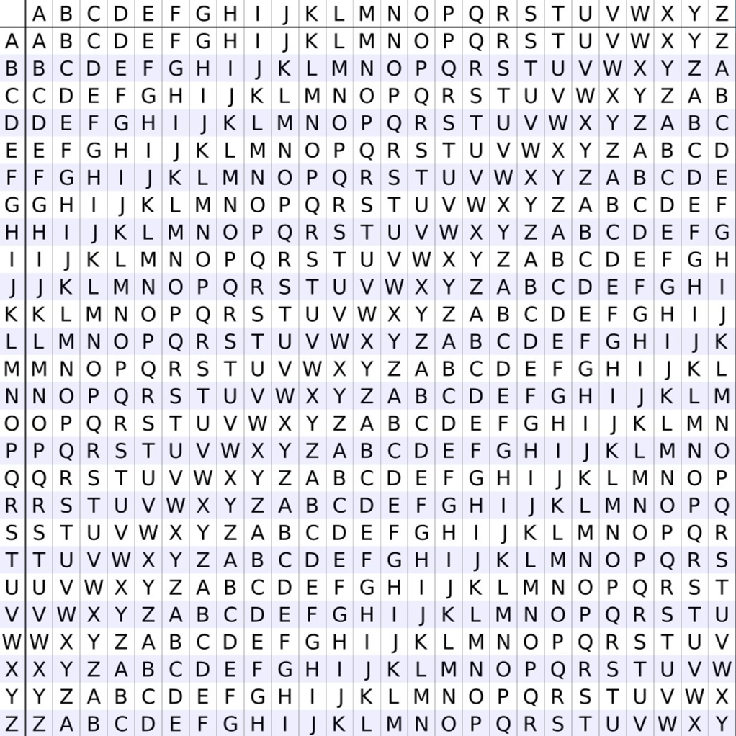
USAGE
A-Z top row (Base, ‘clear’)
A-Z side row (Encoding)
Five-block format (optional)
EXAMPLE:
Alle Alle Auch Sind Frei (key: magic) =
Mlrm Cxlk Iwoh Yqpp Fxmk (or, 5-block: mlrmc xlklw ohyqp pfxmk)

Slide 5
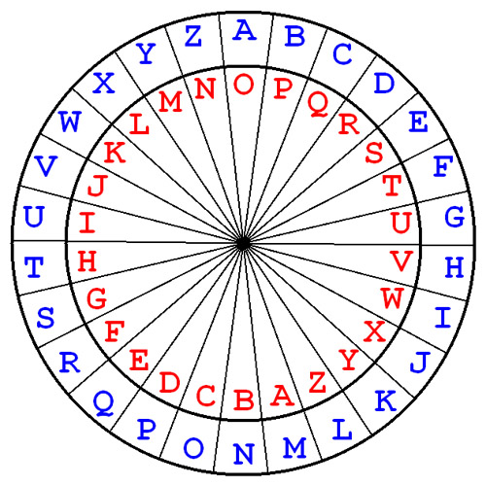
Cipher Disk
Two disks on top of another
Outer disk is plane text
Inner disk is keyword
Easier way to decode without using the table
Plain text: Hofstras University
Keyword: Houghton
EXAMPLE:
H o f s t r a s T e c h
H O UGHTO N H O U G
E = S

Slide 6

Saint Cyr Slide
Top slide is plain text
Bottom slide is keyword
Plain text: Hofstras University
Keyword: Houghton
EXAMPLE:
H o f s t r a s T e c h
H O UGHTO N H O U G
E = S

Slide 7

SOVIET KOMITET GOSUDARSTVENNOY BEZOPASNOSTI
Cold War (Why did they still use this???)
Dead Drops were used
Praise be they shut down in 1991 (Also I ran out of budget for this slide)

Slide 8
AUTOKEY
1. Leon Battista Alberti
Original creator of the Vigenere cipher, circa 1467. Published officially in 1518.
2. Vigenere Steals the Name
1586.
Blaise de Vigenere publishes his “Autokey” cipher. A simpler version of Alberti’s cipher
3. 300 years
For roughly three centuries, the Vigenere cipher was unbreakable, and earned the name “le chiffrage indéchiffrable”

Slide 9


Quiz Time

Slide 10
Who invented the Vigenere cipher?
A)
Blaise de Vigenère
B)
Julius Caesar
C)
Samuel Morse
D)
Leon Battista Alberti

Slide 11
How many Vigenere devices are there?
A)
1
B)
2
C)
3

Slide 12
Whos better?
A)
Leon Battista Alberti
BOTH OF THEM CAUSE WE LIKE CIPHERS
B)
Julius Caesar

Slide 13
Questions?
DON’T FORGET TO NEVER STOP HATING ON BLAISE DE VIGENERE

Slide 14
RESOURCES
https://www.ebsco.com/research-starters/history/vigenere-cipher
https://cangea.com/history-of-cryptography-the-vigenere-cipher/
https://www.kaspersky.com/blog/vigenere-cipher-history/9802/
https://lflank.wordpress.com/2025/02/18/the-vigenere-cipher/
Image Sources: Wikimedia Commons

